Slide 1
PowerShell Een introductie
Ben van Zanten
Technical Consultant

Slide 2


Is it a bird ? Is it a plane? NO! it is …

Slide 3
PowerShell training - Agenda
L1 Basis introductie
L2 Introductie (cont)
L3 PowerShell voor beheer
L4 PowerShell in productie
…

Slide 4
L1 Basis introductie
Basis introductie
Wat is PowerShell
Hoe start en configureer ik PowerShell
PowerShell beveiliging
Syntax

Slide 5
L2 Introductie - continued
Introductie (cont)
Diepere intro
Objecten
PowerShell Pipeline

Slide 6
L3 PowerShell voor beheer
PowerShell voor beheer
Modules, Snapins
Add-ons
Scheduling scripts
Logging
Input, output
XML, CSV, INI, XLSx
Remoting

Slide 7
L4 PowerShell in productie
PowerShell in productie
Help en documentatie in powershell
Script signing
Modules
Parameters
Safe scripting : Error handling
Safe scripting : ShouldProcess : Whatif, Confirm, Verbose, Force
Development Repository
Locatie
Versioning systeem SVN, GIT, CSV, Microsoft Team

Slide 8
L.. wvttk
PowerShell deepdive (?)
PowerShell for applications
Active Directory
Sharepoint

Slide 9
L1 Basis introductie
Basis introductie
Wat is PowerShell
Hoe start en configureer ik PowerShell
PowerShell beveiliging
Syntax

Slide 10




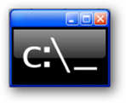





Wat is PowerShell ?
Neem het beste uit …
En verbindt dat met …

Slide 11
DEMO: PSDrive support voor Registry, file, certificates, WMI
Dir C:\Temp
Dir HKLM:\Software\Microsoft\Windows\CurrentVersion\Setup
Dir Cert:\LocalMachine\My
Get-WmiObject Win32_Volume
Get-WmiObject Win32_Volume | Format-Table -Property Caption,DriveLetter,DriveType,Label,Capacity,FreeSpace -AutoSize

Slide 12

DEMO : .NET Framework support (1)
[Reflection.Assembly]::LoadWithPartialName("System.Windows.Forms") | Out-Null
$OpenFile = New-Object System.Windows.Forms.OpenFileDialog
$OpenFile.Filter = "log files (*.log)|*.log|All files (*.*)|*.*"
if ($OpenFile.ShowDialog() -eq "OK" ) { Get-Content $OpenFile.FileName }
$source = "http://icons.iconarchive.com/icons/google/chrome/256/Google-Chrome-icon.png"
$destination = "C:\Temp\Google-Chrome-icon.png"
If (!(Test-Path C:\Temp)) { MD C:\Temp }
$wc = New-Object System.Net.WebClient
$wc.DownloadFile($source, $destination)
Dir $destination
Start-Process -FilePath $destination

Slide 13
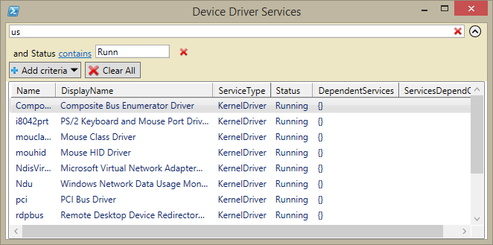
DEMO : .NET Framework support (2)
Function Get-DeviceDriverService { Param([string]$computer="localhost")
Add-Type -AssemblyName System.ServiceProcess
[System.ServiceProcess.ServiceController]::GetDevices($computer)
}
Get-DeviceDriverService -computer "Localhost" |
Select-Object -Property name, displayname, servicetype, status,
DependentServices, ServicesDependOn |
Out-GridView -Title "Device Driver Services"

Slide 14
Demo: putting it all together
$Excel = New-Object -ComObject "Excel.Application"
$Excel.Visible=$True
$Workbook = $Excel.Workbooks.Add()
$diskSpacewksht= $workbook.Worksheets.Item(1)
$diskSpacewksht.Name = 'DriveSpace'
$diskSpacewksht.Cells.Item(1,1) = 'Caption'
$diskSpacewksht.Cells.Item(1,2) = 'DriveLetter'
$diskSpacewksht.Cells.Item(1,3) = 'Label'
$diskSpacewksht.Cells.Item(1,4) = 'Size(GB)'
$diskSpacewksht.Cells.Item(1,5) = 'FreeSpace(GB)'
$row = 2
Get-CimInstance -ClassName Win32_Volume | ForEach {
$diskSpacewksht.Cells.Item($row,1) = $_.Caption
$diskSpacewksht.Cells.Item($row,2) = $_.DriveLetter
$diskSpacewksht.Cells.Item($row,3) = $_.Label
$diskSpacewksht.Cells.Item($row,4) = ($_.Capacity /1GB)
$diskSpacewksht.Cells.Item($row,5) = ($_.FreeSpace /1GB)
$row++
}
$usedRange = $diskSpacewksht.UsedRange
$usedRange.EntireColumn.AutoFit() | Out-Null
$Excel.DisplayAlerts = $False
$workbook.SaveAs("C:\temp\DiskSpace.xlsx")
$Excel.Quit()

Slide 15
Wat is PowerShell
Een object centric shell
Een script taal
Here to stay
Microsoft strategische keuze voor management tool van de toekomst

Slide 16
PowerShell paradigm
Enterprise efficiency & automation don’t scale on a GUI
Jeffrey Snover (Monad / PowerShell inventor) : Think – Type – Get
CmdLets : Verb-noun
Verb - fixed set of verbs to keep it simple
Noun - Singular!
Objects ipv tekst
Management console, Object centered Management Engine bovenop .NET framework
Scripting language
Snapin / module support
Notes:
http://www.lifehacker.com.au/2013/06/top-10-tactics-for-learning-powershell/

Slide 17
PowerShell Management Engine
PowerShell is a management engine that can be hosted in an application
PowerShell.exe is an application that runs in the CMD window
The PowerShell ISE is a GUI application
3rd party apps can host PowerShell
PowerGui
SAPIEN tech. PowerShell Studio
Idera PowerShell Plus

Slide 18
Is PowerShell for you ?
Yes/No
Yes/No
Yes/No
Yes/No
Do you want a long lasting IT career?
Do you manage Windows Based servers / desktops?
Do you manage MS platforms like Exchange Sharepoint System Center
Do you need repeatable and consistent mgmt tools?
Do you need to do more with less?
Yes/No

Slide 19
“ it is not a matter of ‘if’ you’ll be using PowerShell, only a matter of ‘when’ “

Slide 20
PowerShell Applicatie support … eva …
Application | Version | Cmdlets | Provider | Management GUI
Windows Server | 2008 | Yes | Yes | No
Windows Compute Cluster Server | 2007 | Yes | Yes | No
Windows 7 Troubleshooting Center^{[76]} | 6.1 | Yes | No | Yes
VMware vSphere PowerCLI^{[74]} | 5.8 R1 | 426 | No | Yes
System Center Virtual Machine Manager | 2007 | Yes | Yes | Yes
System Center Operations Manager | 2007 | 74 | Yes | No
System Center Data Protection Manager | 2007 | Yes | No | No
System Center Configuration Manager | 2012 R2 | 400+ | Yes | No
Special Operations Software Specops Command^{[73]} | 1.0 | Yes | No | Yes
Quest Management Shell for Active Directory^{[72]} | 1.1 | 40 | No | No
NetApp Data ONTAP PowerShell Toolkit^{[78]} | 2.1 | 1158 | Yes | Yes
Microsoft Transporter Suite for Lotus Domino^{[69]} | 08.02.0012 | 47 | No | No
Microsoft SQL Server | 2008 | Yes | Yes | No
Microsoft Sharepoint server | 2010 | Yes | Yes | No

Slide 21
Hoe krijg ik PowerShell
Installatie:
Build-in Windows 7 en hoger
Installable op oudere OS versies, builtin maar upgradeable op nieuwere OS versies
Requirements:
.NET Framework (2.3.4)
Versies
1.0 (2006) Win XP sp2, WS2003, Vista, WS2008 (optional addin)
2.0 Integr Win 7, WS2008 R2, installable Win XP, WS2003 (req: .NET 2.0) 240 new cmdlets, Remoting, Modules, e.v.a.
3.0 Integr Win 8, WS2012, installable Win 7SP1, WS2008 SP1 WS 2008 R2 SP1 via WMF 3.0 (req: .NET 4.0) scheduled jobs, Sessions, delegation, automatic module detection
4.0 Integr Win 8.1, WS2012 R2, Installable via WMF 4.0 Desired state configuration
5.0 (WMF 5.0) preview… (repository based pkg management, network switch management, DSC)
Check version:
Get-Host
$PSVersionTable

Slide 22
PowerShell Versions
OS Support | v2 | v3 | v4
.NET Requirement | 2.0 | 4.0 | 4.5
Win XP | Available | No | No
WS2003 | Available | No | No
Win Vista | Available | No | No
WS2008 | Available | Available with SP2 | No
Win 7 | Installed | Available with SP1 | Available
WS2008 R2 | Installed | Available with SP1 | Available
Win 8 | No | Installed | Available
WS2012 | No | Installed | Available
Win 8.1 | No | No | Installed
WS 2012 R2 | No | No | Installed

Slide 23

Let’s get in

Slide 24
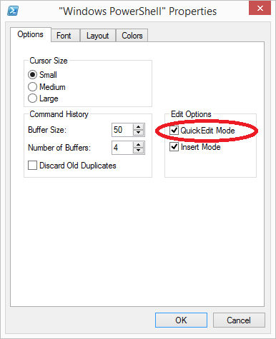
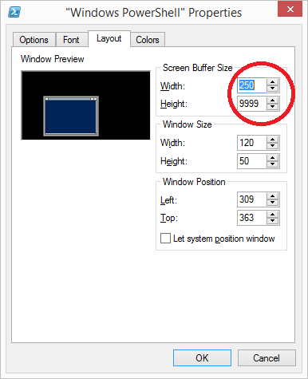
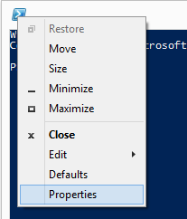
Hoe start en configureer ik PowerShell
Commandline
Configureer QuickEdit Mode
Font moet onderscheid maken tussen ` ' ( { [ < tekens
Configureer Screen Buffer Size
Run as Administrator
Gui (ISE)
Script

Slide 25
Lab – Werken in de Shell
Configureer je PowerShell omgeving
Configureer QuickEdit Mode
Configureer Screen Buffer Size
Gebruik TAB complete om naar de C:\Windows\Logs\DISM directory te gaan. Type:
Cd C:\Wi <tab> \Lo <tab> \Di <tab> <Enter>
Dir
Notepad <dbl Click dism.log> <dbl right-click> <Enter>
doubleclick = Select
right-click = copy (als tekst geselecteerd is)
right-click = paste (als GEEN tekst geselecteerd is)
<esc> = Cancel select. GEBRUIK dit bij per ongeluk selecteren !
Oefen met TAB complete
dir C:\wi <tab> \sy <tab><tab><tab><tab> <Enter>
Selecteer een blok tekst, een woord, een zin
LET OP DE TITELBALK van je venster als je selecteert

Slide 26
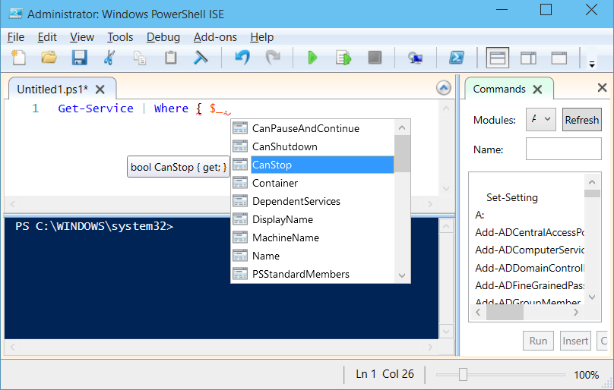
PowerShell ISE Integrated Scripting Environment
Script panel
Tab completion
Intellisense
Snippets
Expandable regions
Color coding
Instant F1 help
Basic debugger
Console panel
Tab completion
Intellisense
Multiple tabs
Remote tabs
Show-command window

Slide 27
PowerShell ISE configuratie
Recently opened files
Recovered files after restarts
Font settings and themes
Panel layout & configuration
Auto save interval
Recent file count
Intellisense timeout

Slide 28
PowerShell ISE gotchas
Only one version installed
ISE is an optional feature on servers
May require additional feature installations (.net 3.5)
Everything runs in a single shared scope

Slide 29
Get-Started Wat je moet weten
PowerShell is object georiënteerd
PowerShell commando’s heten CmdLets
CmdLets hebben vaste vorm: Verb-Noun (ww-zlfst.nmw.)
Verbs zijn vastgelegd. (Get-Verb)
Dus de titel van deze pagina is FOUT! -> Start-PowerShell
Nouns zijn vrij te kiezen
Gebruiken enkelvoud, nooit meervoud. Get-User Get-Volume
Starten vaak met een prefix om Noun uniek te maken
Get-User vs Get-ADUser
NIET caseSensitive

Slide 30
PowerShell ISE advanced
Open files in ISE from PowerShell console
ISE <filename>
Open files in ISE from ISE
Psedit <filename>
The ISE has its own object model
Modify ISE on the fly from PowerShell commands
$psise.options.FontSize=16
$psise.CurrentFile.Editor.InsertText("Hello World")
The ISE can be extended with additional 3rd party tools
The ISE has its own Profile script to configure

Slide 31
LAB - PowerShell ISE
Start ISE op vanaf een PowerShell prompt
Snippet
Druk Ctrl-J en insert een Foreach block
Panes
Druk 2x Ctrl-R om het Script pane (on)zichtbaar te maken
Configure
Gebruik Tools – Options – General settings om de configuratie aan te passen

Slide 32
Eenvoudige start
Aliassen voor bekende commando’s
TAB completion
Get-Help

Slide 33
PowerShell Alias vereenvoudigt de overstap
PowerShell (Cmdlet) | PowerShell (Alias) | CMD.EXE / COMMAND.COM | Unix shell | Description
Pop-Location | popd | popd | popd | Change the current directory to the directory most recently pushed onto the stack
Push-Location | pushd | pushd | pushd | Push the current directory onto the stack
Set-Location | sl, cd, chdir | cd, chdir | cd | Change the current directory
Tee-Object | tee | N/A | tee | Pipe input to a file or variable, then pass the input along the pipeline
Write-Output | echo, write | echo | echo | Print strings, variables etc. to standard output
Get-Process | gps, ps | tlist,^{[Note 2]}tasklist^{[Note 3]} | ps | List all currently running processes
Stop-Process | spps, kill | kill,^{[Note 2]}taskkill^{[Note 3]} | kill^{[Note 4]} | Stop a running process
Select-String | sls | find, findstr | grep | Print lines matching a pattern
Set-Variable | sv, set | set | env, export, set, setenv | Set the value of a variable / create a variable
Invoke-WebRequest | iwr, curl, wget | N/A | wget, cURL | Gets content from a web page on the Internet

Slide 34
PowerShell Alias vereenvoudigt de overstap
PowerShell (Cmdlet) | PowerShell (Alias) | CMD.EXE / COMMAND.COM | Unix shell | Description
Get-ChildItem | gci, dir, ls | dir | ls | List all files / directories in the (current) directory
Get-Content | gc, type, cat | type | cat | Get the content of a file
Get-Command | gcm | help | help, which | List available commands
Get-Help | help, man | help | man | Help on commands
Clear-Host | cls, clear | cls | clear | Clear the screen^{[Note 1]}
Copy-Item | cpi, copy, cp | copy | cp | Copy one or several files / a whole directory tree
Move-Item | mi, move, mv | move | mv | Move a file / a directory to a new location
Remove-Item | ri, del, erase, rmdir, rd, rm | del, erase, rmdir, rd | rm, rmdir | Delete a file / a directory
Rename-Item | rni, ren, mv | ren, rename | mv | Rename a file / a directory
Get-Location | gl, pwd | cd | pwd | Display the current directory/present working directory.

Slide 35
Lab - Werken met Aliassen
Dir (Windows) en LS (unix) zijn commando’s om files/folders te bekijken
Dir C:\Temp
LS C:\Temp
Get-Alias Dir
Dus “dir” is een alias voor Get-Childitem
Get-Childitem C:\Temp
Echo (Windows) is een alias voor Write-Output
echo "Test" > C:\Temp\Test.txt
Help echo
Type is een alias voor Get-Content
type C:\Temp\Test.txt
Help type
Get-Content C:\Temp\Test.txt
ps (Unix) is een alias voor Get-Process
Notepad
Ps notepad
Get-Process notepad
Get-Process notepad | Stop-Process

Slide 36
Get-Started De 4 enige commando’s die je moet kennen
Get-Help (help)
Get-Command (GC)
Get-Member (GM) -> Les2 Objecten
Format-List (FL) / Format-Table (FT)

Slide 37
Get-Started Andere veelgebruikte commando’s
Get-PSDrive
Get-Process
Get-Service
Get-Date
Get-Coffee

Slide 38
Get-Help
Help
Get-Help <cmdlet> | About_*
Get-Help <cmdlet> -Detailed
Get-Help <cmdlet> -Full
Get-Help <cmdlet> -Examples
Get-Help Get-Member | Clip
Get-Help -ShowWindow
PS 3.0: Help is not fully installed by default!
Get-Help -Online
Update-Help [-Module *] [-Force] [-UICulture "en-us"]
Save-Help

Slide 39
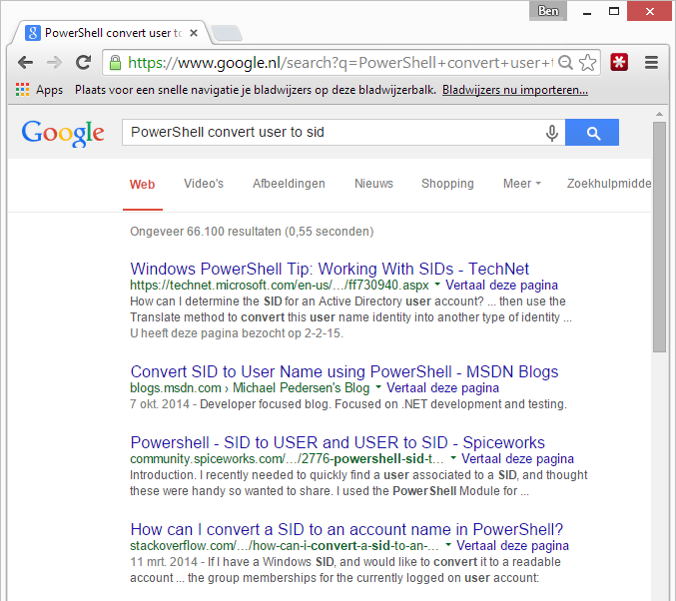
Get-Help (2)
http://www.google.nl

Slide 40
LAB : Get-Help
Bekijk de get-* CmdLets die beschikbaar zijn
Bekijk de about_* topics die beschikbaar zijn
Update de help naar de laatste versies. (Local admin account & read rights on share required)
Update-Help -UICulture "en-US" –Force -SourcePath \\nfcpca01\SoftwareRepository\Software\Microsoft\PowerShell\PSHelp
Bekijk opnieuw de about_ topics
Get-Help about_*
Help about_*Param*
Help about_Comparison_Operators
Bekijk de help van het Get-Process CmdLet
Help Get-Process
Help Get-Process -Detailed
Help Get-Process -Full
Help Get-Process -Examples

Slide 41
Get-Command
Get-Help Get-Command
SYNOPSIS
Gets all commands.
Example
PS M:\> (Get-Command).Count
1557 (WS2012 Core DC,1589 WS2012 Core Hyper-V)
1150 (W8.1 6.3.9600)
2369 (W10 preview 6.4.9841 + RSAT)
Example
Import-Module ServerManager
Get-Command –Module ServerManager
Example
PS M:\> Get-Command | Group-Object -Property ModuleName

Slide 42
LAB : Get-Command
Bekijk de commando’s die in de ActiveDirectory module aanwezig zijn
Get-Command -Module ActiveDirectory
Bekijk de help van een van die commando’s
Get-Help Get-ADUser
Get-Help Get-ADUser -Online

Slide 43
PowerShell security (basic)
.ps1 powershell bestanden associatie: Notepad
( .vbs -> run mbv Wscript, .bat/.cmd -> with with CMD)
VERANDER DIT NIET
ExecutionPolicy
(signed) Scripts can / cannot run
Scripts in current folder don’t run
Use .\ invocation, or full path
Echo ‘ “Hello World” ‘ > C:\Temp\RunMe.ps1
.\RunMe.ps1
C:\Temp\RunMe.ps1
UAC User Account Control
Run powershell / scripts with Run As Administrator
Notes:
http://www.darkoperator.com/blog/2013/3/5/powershell-basics-execution-policy-part-1.html
Set-AuthenticodeSignature .\hello.ps1 -Certificate $acert

Slide 44
PowerShell ExecutionPolicy
Get-ExecutionPolicy -List | ft –AutoSize
Set-ExecutionPolicy (rechten nodig)
Set-ExecutionPolicy Bypass -Scope Process
PowerShell.exe -ExecutionPolicy Bypass -File .runme.ps1
ExecutionPolicy
Restricted | No script can run | Orig default
AllSigned | Only digital signed scripts
RemoteSigned | Local scripts run, downloaded / remote(UNC) scripts don’t
Unrestricted | All scripts can run | (warning in W8)
ByPass | All scripts can run
Notes:
https://blog.netspi.com/15-ways-to-bypass-the-powershell-execution-policy/

Slide 45
LAB : PowerShell security
Bekijk je locale ExecutionPolicy, Zet evt op restricted
Set-ExecutionPolicy Restricted -Force
Creëer een mini-script, probeer hem uit te voeren
MD C:\Temp
CD C:\Temp
Echo ' "Hello World" ' > Hello.ps1
.\Hello.ps1
Zet je executionpolicy op RemoteSigned, probeer het script opnieuw
Set-ExecutionPolicy RemoteSigned -Force
.\Hello.ps1
Vanuit de Explorer, dubbelklik op je script in C:\Temp

Slide 46
PowerShell default file extensies
.ps1 Default extensie PowerShell script
.psd1 PowerShell Data file
.psm1 PowerShell module file
.ps1xml PowerShell format & type definitions (out - scope)
.clixml PowerShell serialized data
.psc1 PowerShell console file
.pssc PowerShell session configuration file

Slide 47
HUISWERK
Objecten
Vraag help op, over alle CmdLets die ‘-Object’ bevatten
Get-Help *-Object
Bekijk de help van ELK van deze cmdlets, en speel ermee
Minimaal: Select- ForEach- Where- evt: Sort- Group- Measure-
We gaan hier de volgende les veel gebruik van maken
CmdLets voor jezelf:
Bepaal welke modules er aanwezig zijn in PowerShell
Welke is het meest interessant voor jezelf ? (Win, Sql, Sharepoint)
Bekijk de CmdLets van de voor jou belangrijkste Module

Slide 48

Vragen

